Slide 1
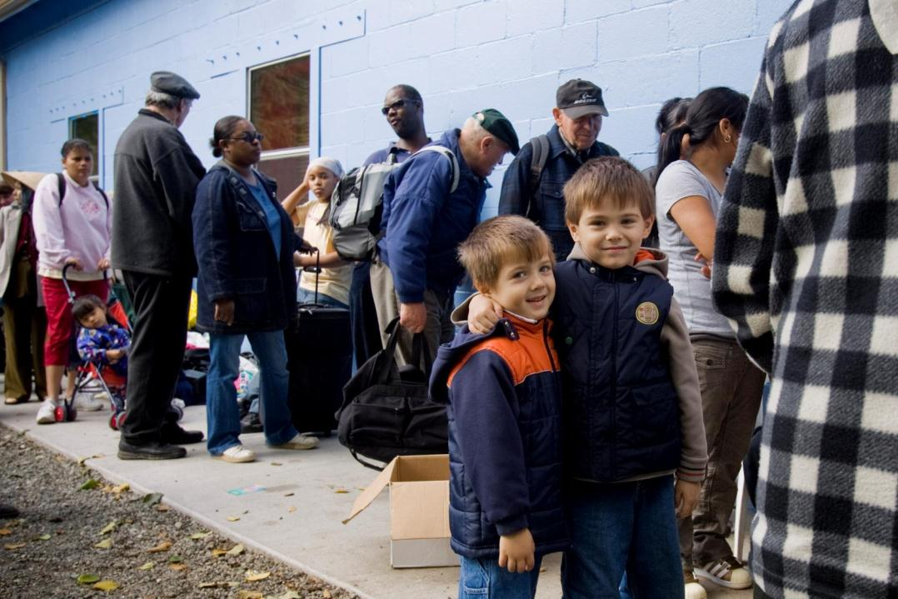

Your Rotary Foundation
Endowment Update

Slide 2
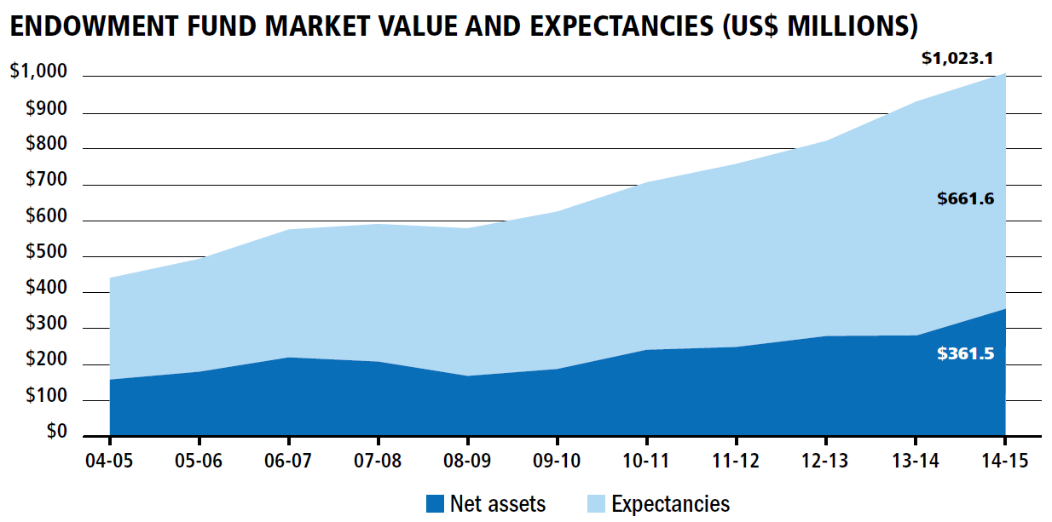
Endowment Fund Growth

Slide 3
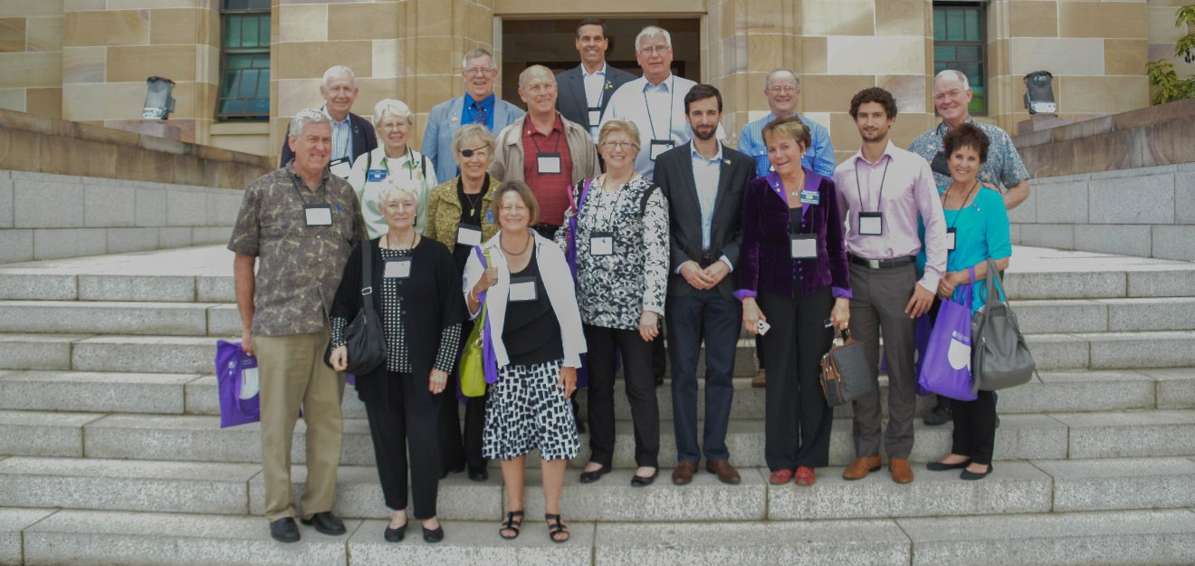
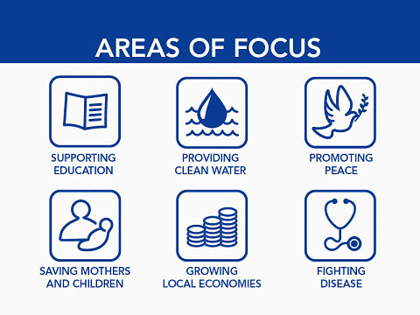
Notes:
As an area of focus-projects will train local adult and yough leaders to prevent and mediate conflict as well as supporting long term peace-building in areas affected by conflict. Related to this is a seperate endowment priority area of funding to support and expand our educational focus through the Rotary Peace Centers program. (invite Chris to comment)
You may be most passionate about peace and conflict resolution and want to endow a scholar at one of Rotary’s Peace Centers. Which is what my wife and I decided to do.

Slide 4
Endowed Peace Fellows
Creating a Rotary Legacy by Endowing Rotary Peace Centers
  In addition to creating a basic Named Fund to support Peace Centers (starting at $25,000) the following options are unique to donors who choose to support Rotary Peace Centers with a gift to the Endowment Fund. Gifts can be made in cash or via bequest.
  $100,000 - Endows an annual seminar at a Rotary Peace Center
  $250,000 – Endows one certificate program Peace fellow every year
  $500,000 - Endows one two-year Peace Fellow every three years
  $750,000 – Endows one two-year Rotary Peace Fellow every two years
  $1 Million – Endows one visiting lecturer each year
  $1.5 Million – Endows one Rotary Peace Fellow at a two-year Rotary Peace center every year

Slide 5
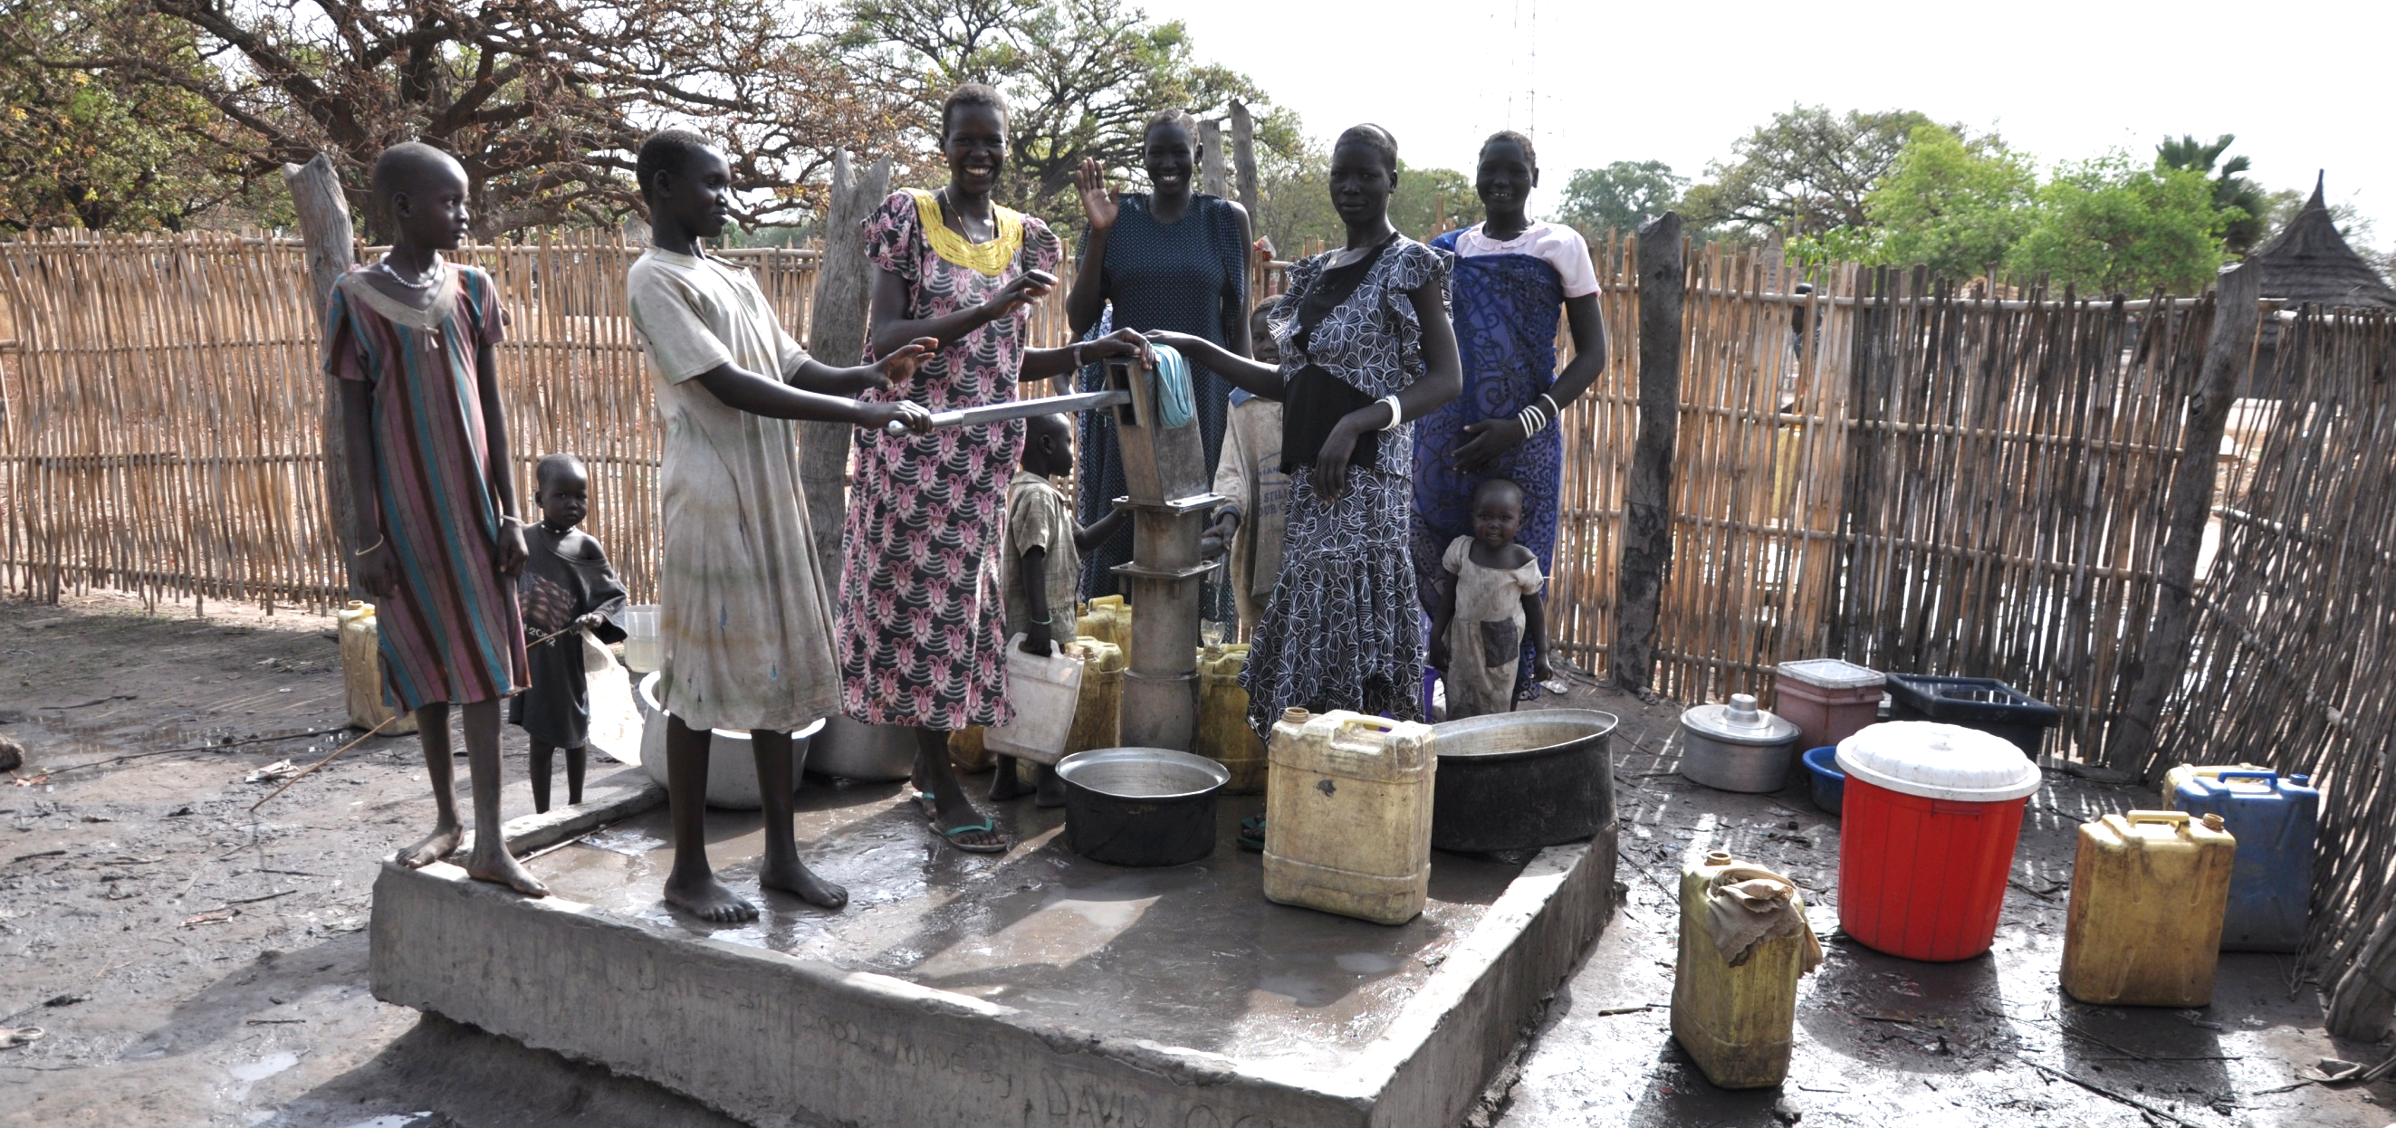
Notes:
clean - clear - potable water and good sanitation are a corner stones of a good healthy environment for a village. Rotarian's Global grant project work and gifts of support to this area of focus will provide equitalbe community access to safe water and improved sanitation and hygiene and work to stregthen the ability of communities to develop, fund and maintatin sustainable water and sanitation systems.

Slide 6
Named Funds
Creating a Rotary Legacy by Supporting the Endowment Fund
  When a donor gives $25,000 or more to the Endowment Fund and designates the earnings from that gift to be directed to either A. World Fund (Trustees Discretion), B. SHARE (half World Fund and half District Designated Funds) or C. Rotary Peace Centers, then the donor may create a named fund.
  The gift can be made in life (cash) or through a bequest
  The funds are comingled for investment purposes in the Endowment Fund and the fund’s growth and spending is reported each year in a custom report to the donor (and when the gift is supporting SHARE, to the donor’s district).

Slide 7
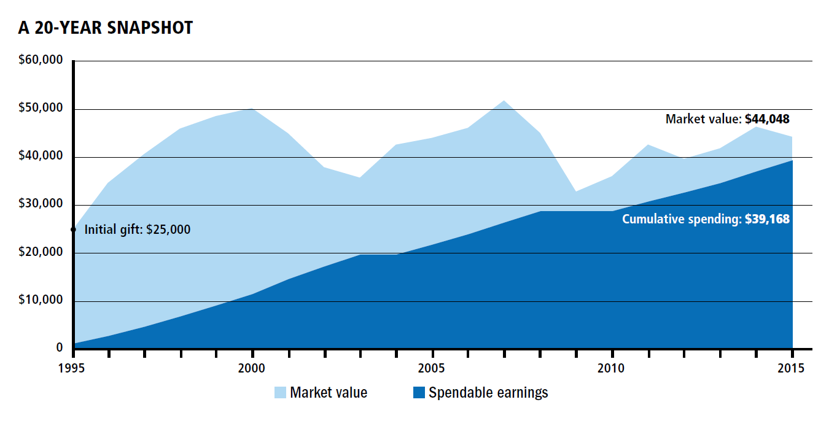
The Power of Endowment Giving
Endowed fund growth in 20 years ago a gift of $25,000 = $44,048
The endowed fund has provided $39,168 in spendable earnings.
Notes:
Here is an example of an investment in our endowment fund. A generous gift of $25,000 in the past 20 years has the current market value of nearly $40,000 and has provided more than $33,000 to the humanitarian work of The Rotary Foundation. This is how you can leave a legacy to do good in the world. You can find this illustation inside of the Endowment fund report-available for order or on line at www.rotary.org.

Slide 8

Ways To Give
  Cash (Major Donor Recognition)
  Pledge (Major Donor Recognition)
  Gift of Stock (Major Donor Recognition)
  IRA Rollover Gift (Major Donor Recognition)
  Charitable Gift Annuity (CGA) (Major Donor Recognition)
  Charitable Remainder Trust (CRT) (Major Donor Recognition)
  Life Insurance (ownership and/or beneficiary designation) (Usually Bequest Society)
  Bequest (Bequest Society Recognition)
  Beneficiary Designation (Bequest Society)

Slide 9
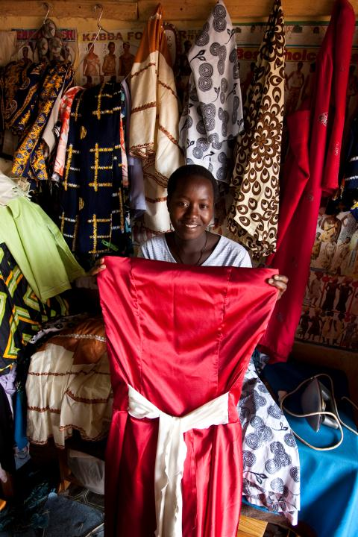
You can do good in the world!
There are 300,000+ US Rotarians.
If each one made a bequest of $10,000 then the next generation of Rotarians would have $3 Billion with which to do good in the world.

Slide 10
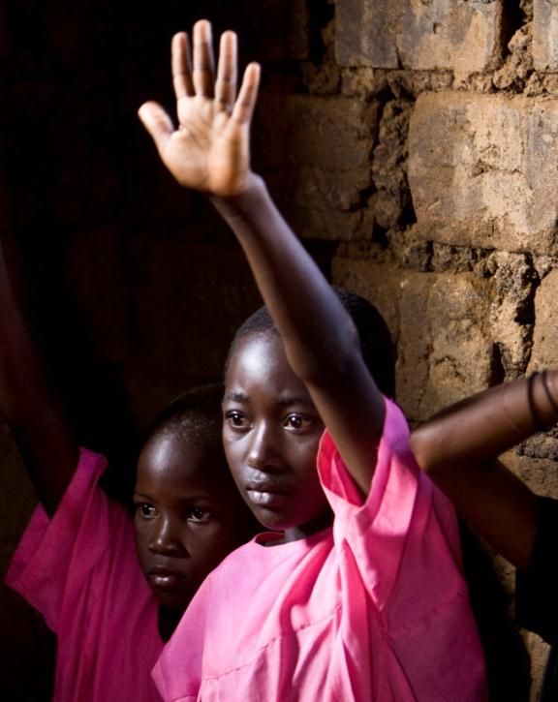
Questions?

